Slide 1

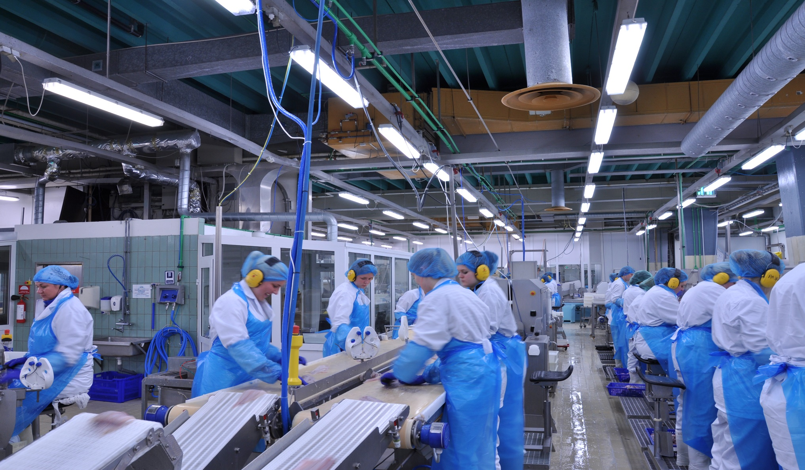
Schwan’s – Use Case – Manufacturing Analytics – Predict Plant Outage

Slide 2
Predict Plants Outage :
Goal :
Predict Manufacturing Plants Outage.
Use Case :
During a workshop at client site a use case came up on top of the list. How to reduce or even predict Manufacturing plants outage hours or days in advance.
Approach :
Sogeti Team rolled the sleeves and developed a demonstration of state of the art.
This model comprises of another Manufacturing units dataset , sources are telemetry , machine failure , error logs , maintenance and machines configuration(age).
Sogeti Team built a predictive model using this dataset , leveraging statistical techniques to identify the influence of certain errors, machine unique ID and machine components which are predicted to fail.

Slide 3



Architecture Built :
Telemetry
OEM Automated Data Capture Software(s) e.g. ROCKWELL,REDZONE,TRIHEDRAL,WONDERWARE e.t.c.
Predictions on –
Relative Influence on Machine outage
Component(s) causing failure
Voltage , model and age leading failure
Certain errors in given plant and/or machine
Maintenance
Machine Failures
Error Logs
Receives health score
Machine Configuration
Data Source
Nature of Data
Machine Learning Model
Predictive Model hosting on Azure Cloud

Slide 4
Dataset View:
Telemetry
datetime | machineID | volt | rotate | pressure | vibration
1/1/2015 6:00 | 1 | 176.217853 | 418.5040782 | 113.0779355 | 45.08768576
1/1/2015 7:00 | 1 | 162.8792229 | 402.7474896 | 95.46052538 | 43.41397268
Maintenance
datetime | machineID | comp
6/1/2014 6:00 | 1 | comp2
7/16/2014 6:00 | 1 | comp4
Machine Failures
datetime | machineID | failure
1/5/2015 6:00 | 1 | comp4
3/6/2015 6:00 | 1 | comp1
Components are categorized comp1 to comp5
Models are categorized as model1 to model5
Machines are given unique ID 1 to 100
Error Logs
datetime | machineID | errorID
1/3/2015 7:00 | 1 | error1
1/3/2015 20:00 | 1 | error3
Machine Configuration
machineID | model | age
1 | model3 | 18
2 | model4 | 7
Data Source

Slide 5
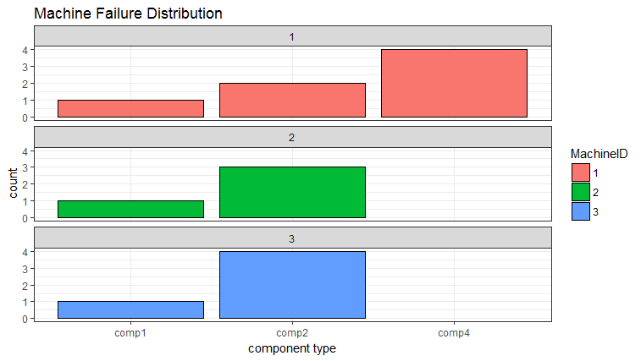
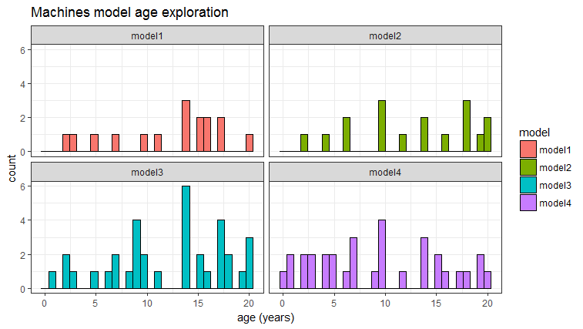
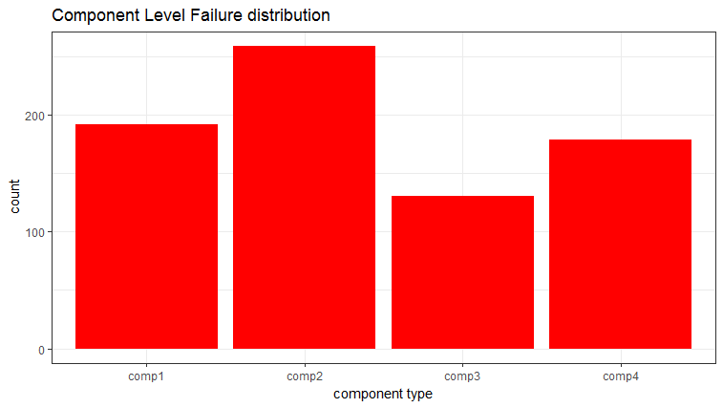
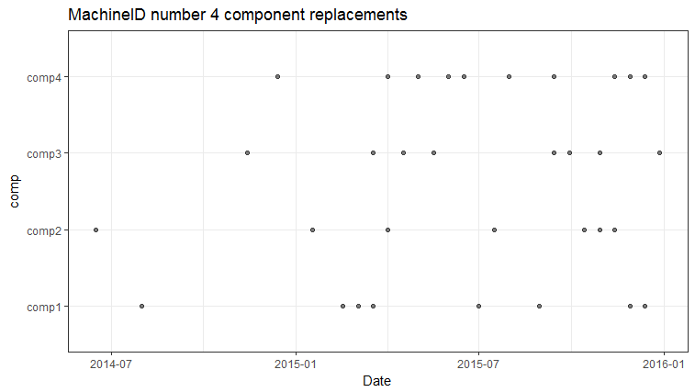
Explorations on Dataset:

Slide 6
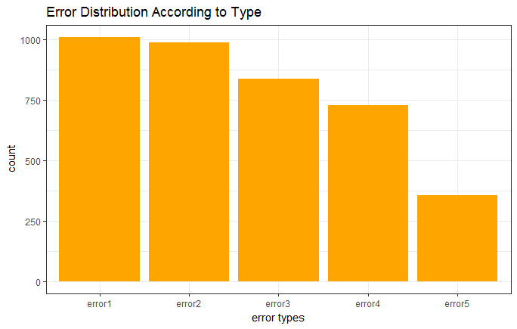
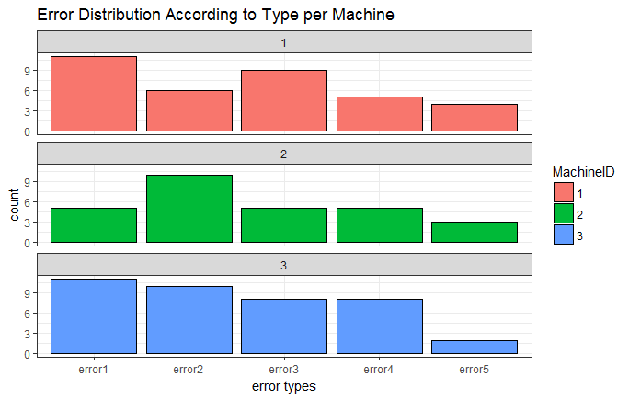
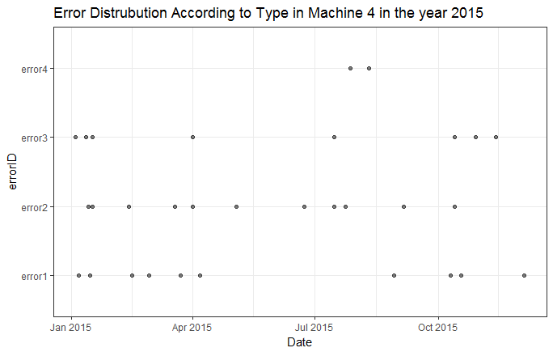
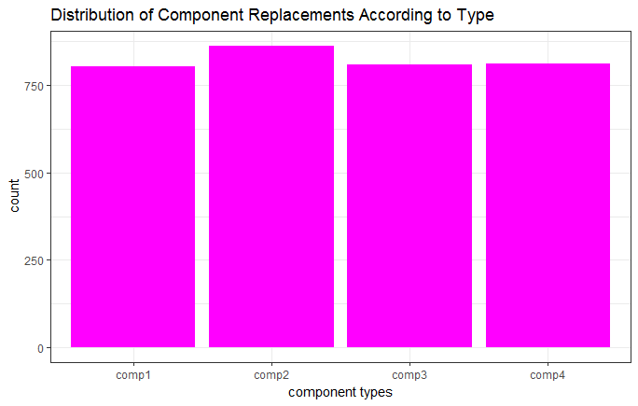
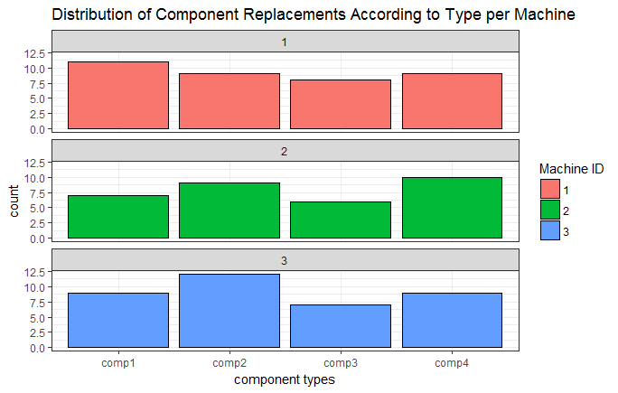
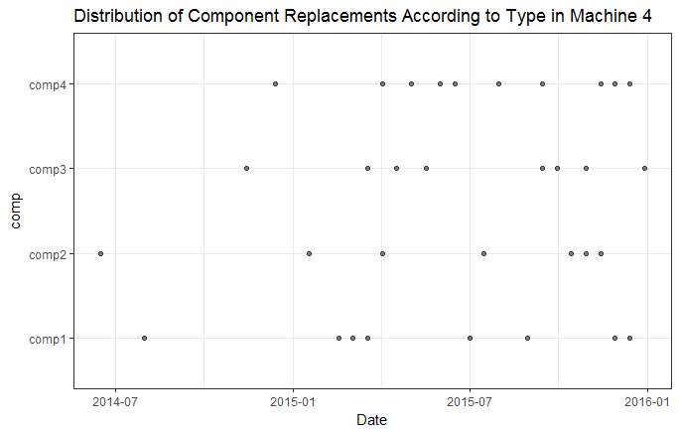

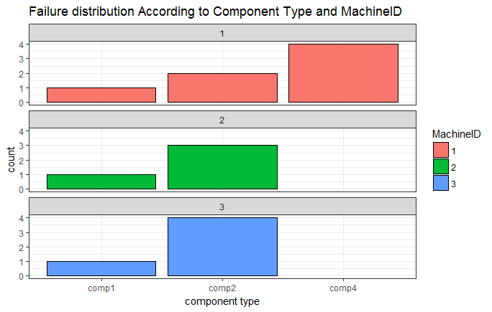
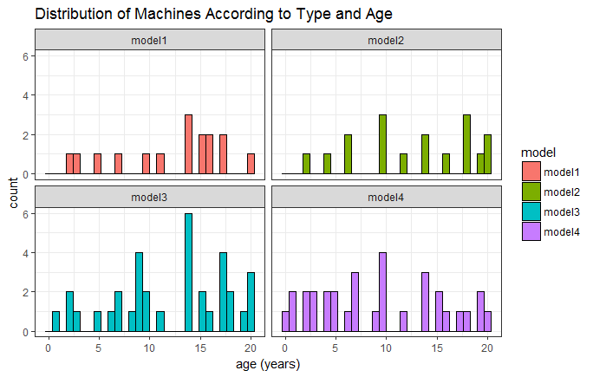
Explorations on Dataset:
Error Distribution
Maintenance Distribution
Failure Distribution

Slide 7
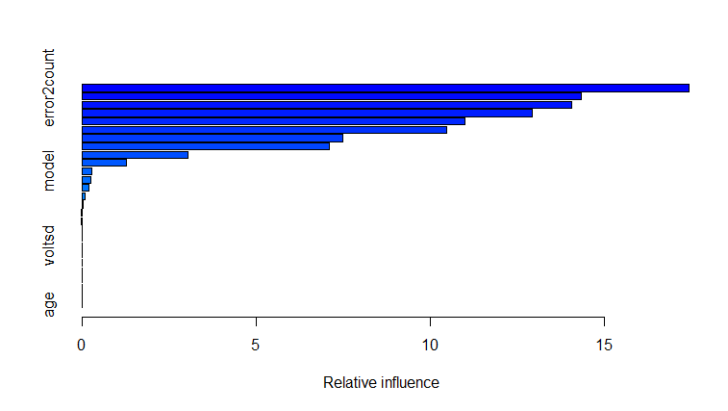
Insights to Predictions :
 | variable | Relative Influence
error2count | error2count | 17.55478
error5count | error5count | 14.92207
voltmean_24hrs | voltmean_24hrs | 14.2271
vibrationmean_24hrs | vibrationmean_24hrs | 12.93978
error3count | error3count | 11.06276
pressuremean_24hrs | pressuremean_24hrs | 9.595632
rotatemean_24hrs | rotatemean_24hrs | 7.292141
error1count | error1count | 6.60328
error4count | error4count | 3.716549
sincelastcomp1 | sincelastcomp1 | 1.364124
model | model | 0.3032902
sincelastcomp3 | sincelastcomp3 | 0.2124723
vibrationmean | vibrationmean | 0.05653781
rotatemean | rotatemean | 0.03527521
pressuresd_24hrs | pressuresd_24hrs | 0.02871147
sincelastcomp4 | sincelastcomp4 | 0.02720787
age | age | 0.02229394
voltmean | voltmean | 0.01600519
pressuresd | pressuresd | 0.0131631
vibrationsd | vibrationsd | 0.006823297
pressuremean | pressuremean | 0
voltsd | voltsd | 0
rotatesd | rotatesd | 0
voltsd_24hrs | voltsd_24hrs | 0
rotatesd_24hrs | rotatesd_24hrs | 0
vibrationsd_24hrs | vibrationsd_24hrs | 0
sincelastcomp2 | sincelastcomp2 | 0
Summary – Variable error2count is predicted to influence most to cause a certain machine to fail. On the other hand vibrationsd_24hrs and pressuremean are predicted not to cause any failure in next 24 hours (as per the dataset used).

